Slide 1

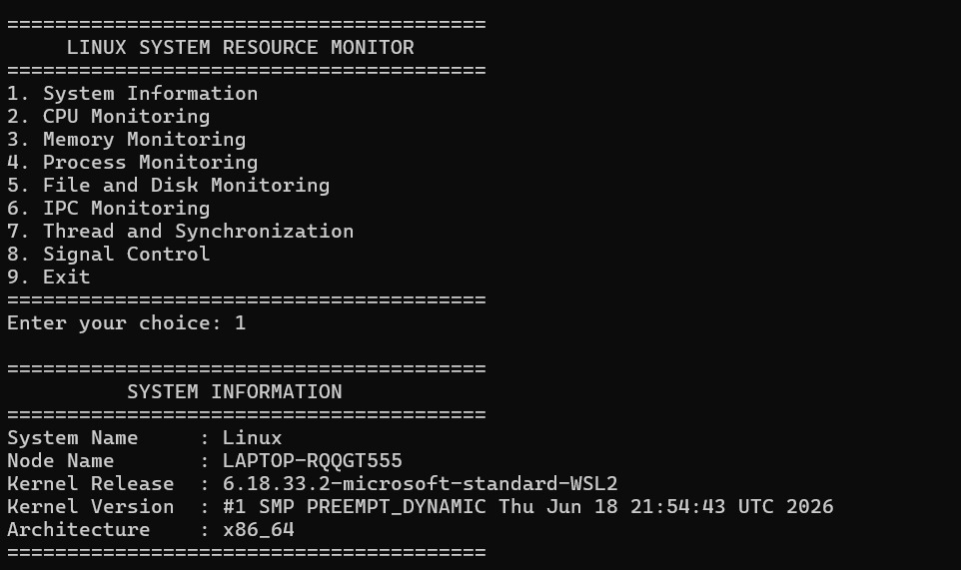
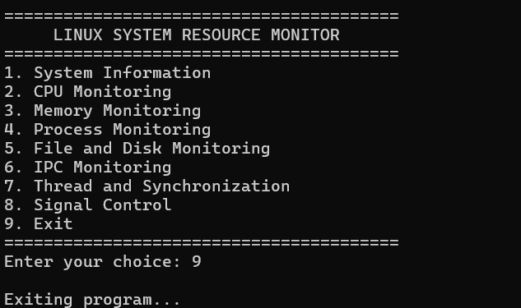
LINUX SYSTEM INFORMATION & RESOURCE MONITORING TOOL
Team ID: 15 | Section: 12 | Members: J. Rakshitha (2520090212), J. Pragathi (2520090216), N. Charishma (2520090214) | Guide: M. Raghupathi
Operating Systems and Systems Programming (OSSP) | KLH Bachupally Campus, CSE | PBL 2026–27
Abstract
Tools & Technologies
A menu-driven Linux command-line application developed in C to display system information and monitor CPU, memory, processes and disk usage. It also demonstrates process communication, POSIX threads, synchronization and signal handling.
The outcome is one modular tool for observing key Linux resources and demonstrating core OSSP concepts.
Programming: C
Platform: Linux / Ubuntu on WSL
OS Concepts: System information, CPU and memory monitoring, processes, file systems, IPC, threads, synchronization and signals
System Calls / APIs: uname(), fork(), pipe(), read(), write(), wait(), statvfs(), pthread APIs, signal(), pause()
Tools: GCC, Make, Git & GitHub, VS Code
Problem Statement & Objectives
Problem: System resource details and OS mechanisms are often checked using separate commands and tools.
Objective 1: Display system, CPU, memory, process and disk information.
Objective 2: Demonstrate IPC, threads, mutex, semaphore and SIGINT handling.
Objective 3: Organize features into reusable C modules with a menu-driven interface.
Scope: Linux/Ubuntu environment; local command-line monitoring and OS concept demonstrations.
System Workflow / Architecture
USER
↓
Menu selection (1–9)
↓
main.c — menu & control flow
↓
Separate C modules
(system • CPU • memory • process • disk • IPC • threads • signals)
↓
Linux /proc, uname(), statvfs(), pipe(), fork(), pthreads, signals
↓
Formatted monitoring output
Existing vs Proposed System
Aspect | Basic / Existing Approach | Proposed Project
Process handling | Check processes separately using system tools. | Lists process IDs and names from Linux /proc.
Communication | No integrated parent–child message exchange. | Uses pipe(), fork(), read(), write() and wait().
Resource handling | Check CPU, memory and disk with separate commands. | Displays CPU, memory and disk details in one menu.
Error handling | Manual checking; output may vary by command. | Modular functions and menu-based operation; tested through compilation and execution.
Key gap | No single learning tool combines these demonstrations. | Combines resource monitoring with IPC, threads and signal handling.
Process, IPC & Resource Design
RESOURCE MONITORING
/proc/stat → CPU usage
/proc/meminfo → memory details
/proc → process IDs and names
statvfs() → disk space
IPC FLOW
Parent process → pipe → Child process
(write message) (read message)
THREAD FLOW
CPU thread + Memory thread
Mutex protects shared counter
Semaphore coordinates execution
Feasibility Study
Technical: Implemented in C using Linux interfaces, GCC and POSIX APIs; runs on Ubuntu/WSL.
Economic: Uses free and open-source tools; no hosting or paid software required.
Operational: Menu-driven interface; users select a monitoring feature and view its output.
Schedule: Project modules, integration, compilation, testing and documentation completed within the PBL timeline.
Implementation Screenshots
ADD SCREENSHOT 1
Main menu / project running in Ubuntu terminal
ADD SCREENSHOT 2
Thread IDs, IPC output or resource-monitoring result
Results & Testing
Conclusion
Future Scope
Tested menu options 1–8 and exit option 9. Verified system details, CPU and memory readings, process list, disk capacity, parent–child pipe message, thread IDs/shared counter and Ctrl+C handling.
Observed successful compilation with Make and successful execution of the monitoring modules.
Implemented a modular C-based Linux monitoring tool with a menu-driven interface. The project demonstrates resource inspection and key OS mechanisms including IPC, POSIX threads, mutexes, semaphores and signal handling.
Add live refresh and historical resource graphs.
Extend process/thread details, input validation and automated test coverage.
References: Linux man-pages (proc, uname, statvfs, pthreads, signals) | GCC / GNU Make documentation | OSSP course material
QR: Add GitHub link

